Slide 1

SynthEddy System Verification and
Validation Plan
Simulating Turbulent Flow with Synthetic Eddy
Phil Du
Phil Du CAS 741

Slide 2
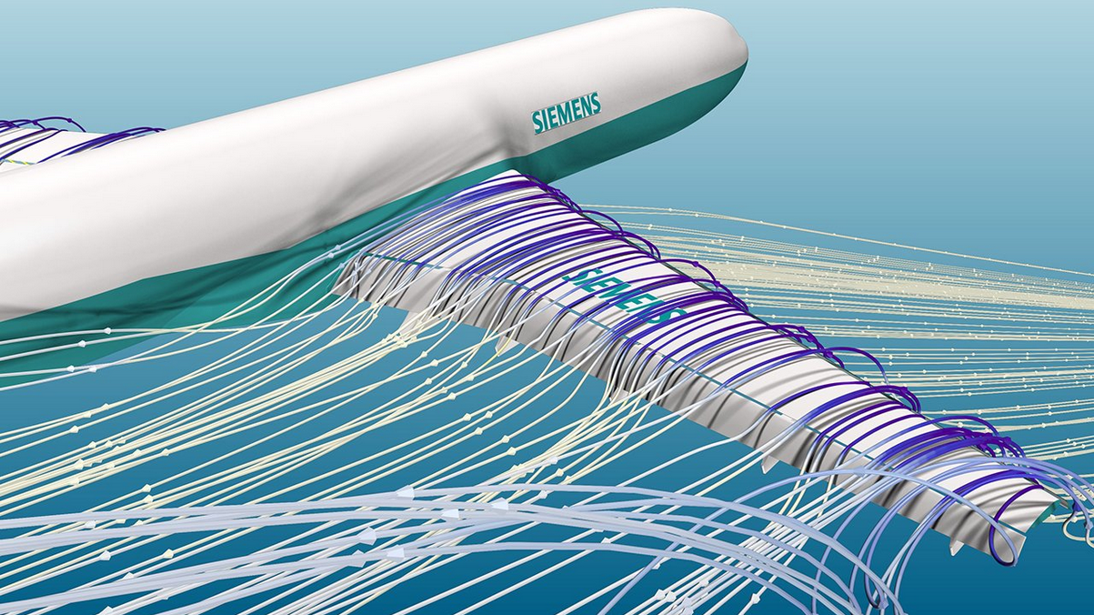
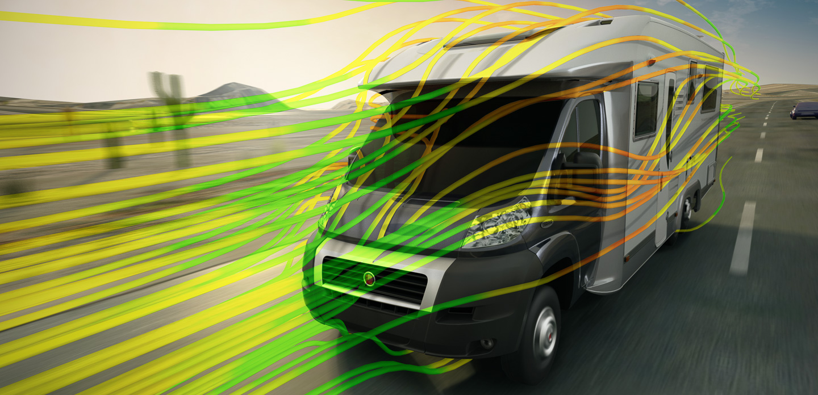
What is CFD
Using computer to simulate fluid (air, water, etc) flow and its interactions with other objects.
Credit: ASCENDTECH GROUP
Credit: SolidWorks
Phil Du CAS 741

Slide 3
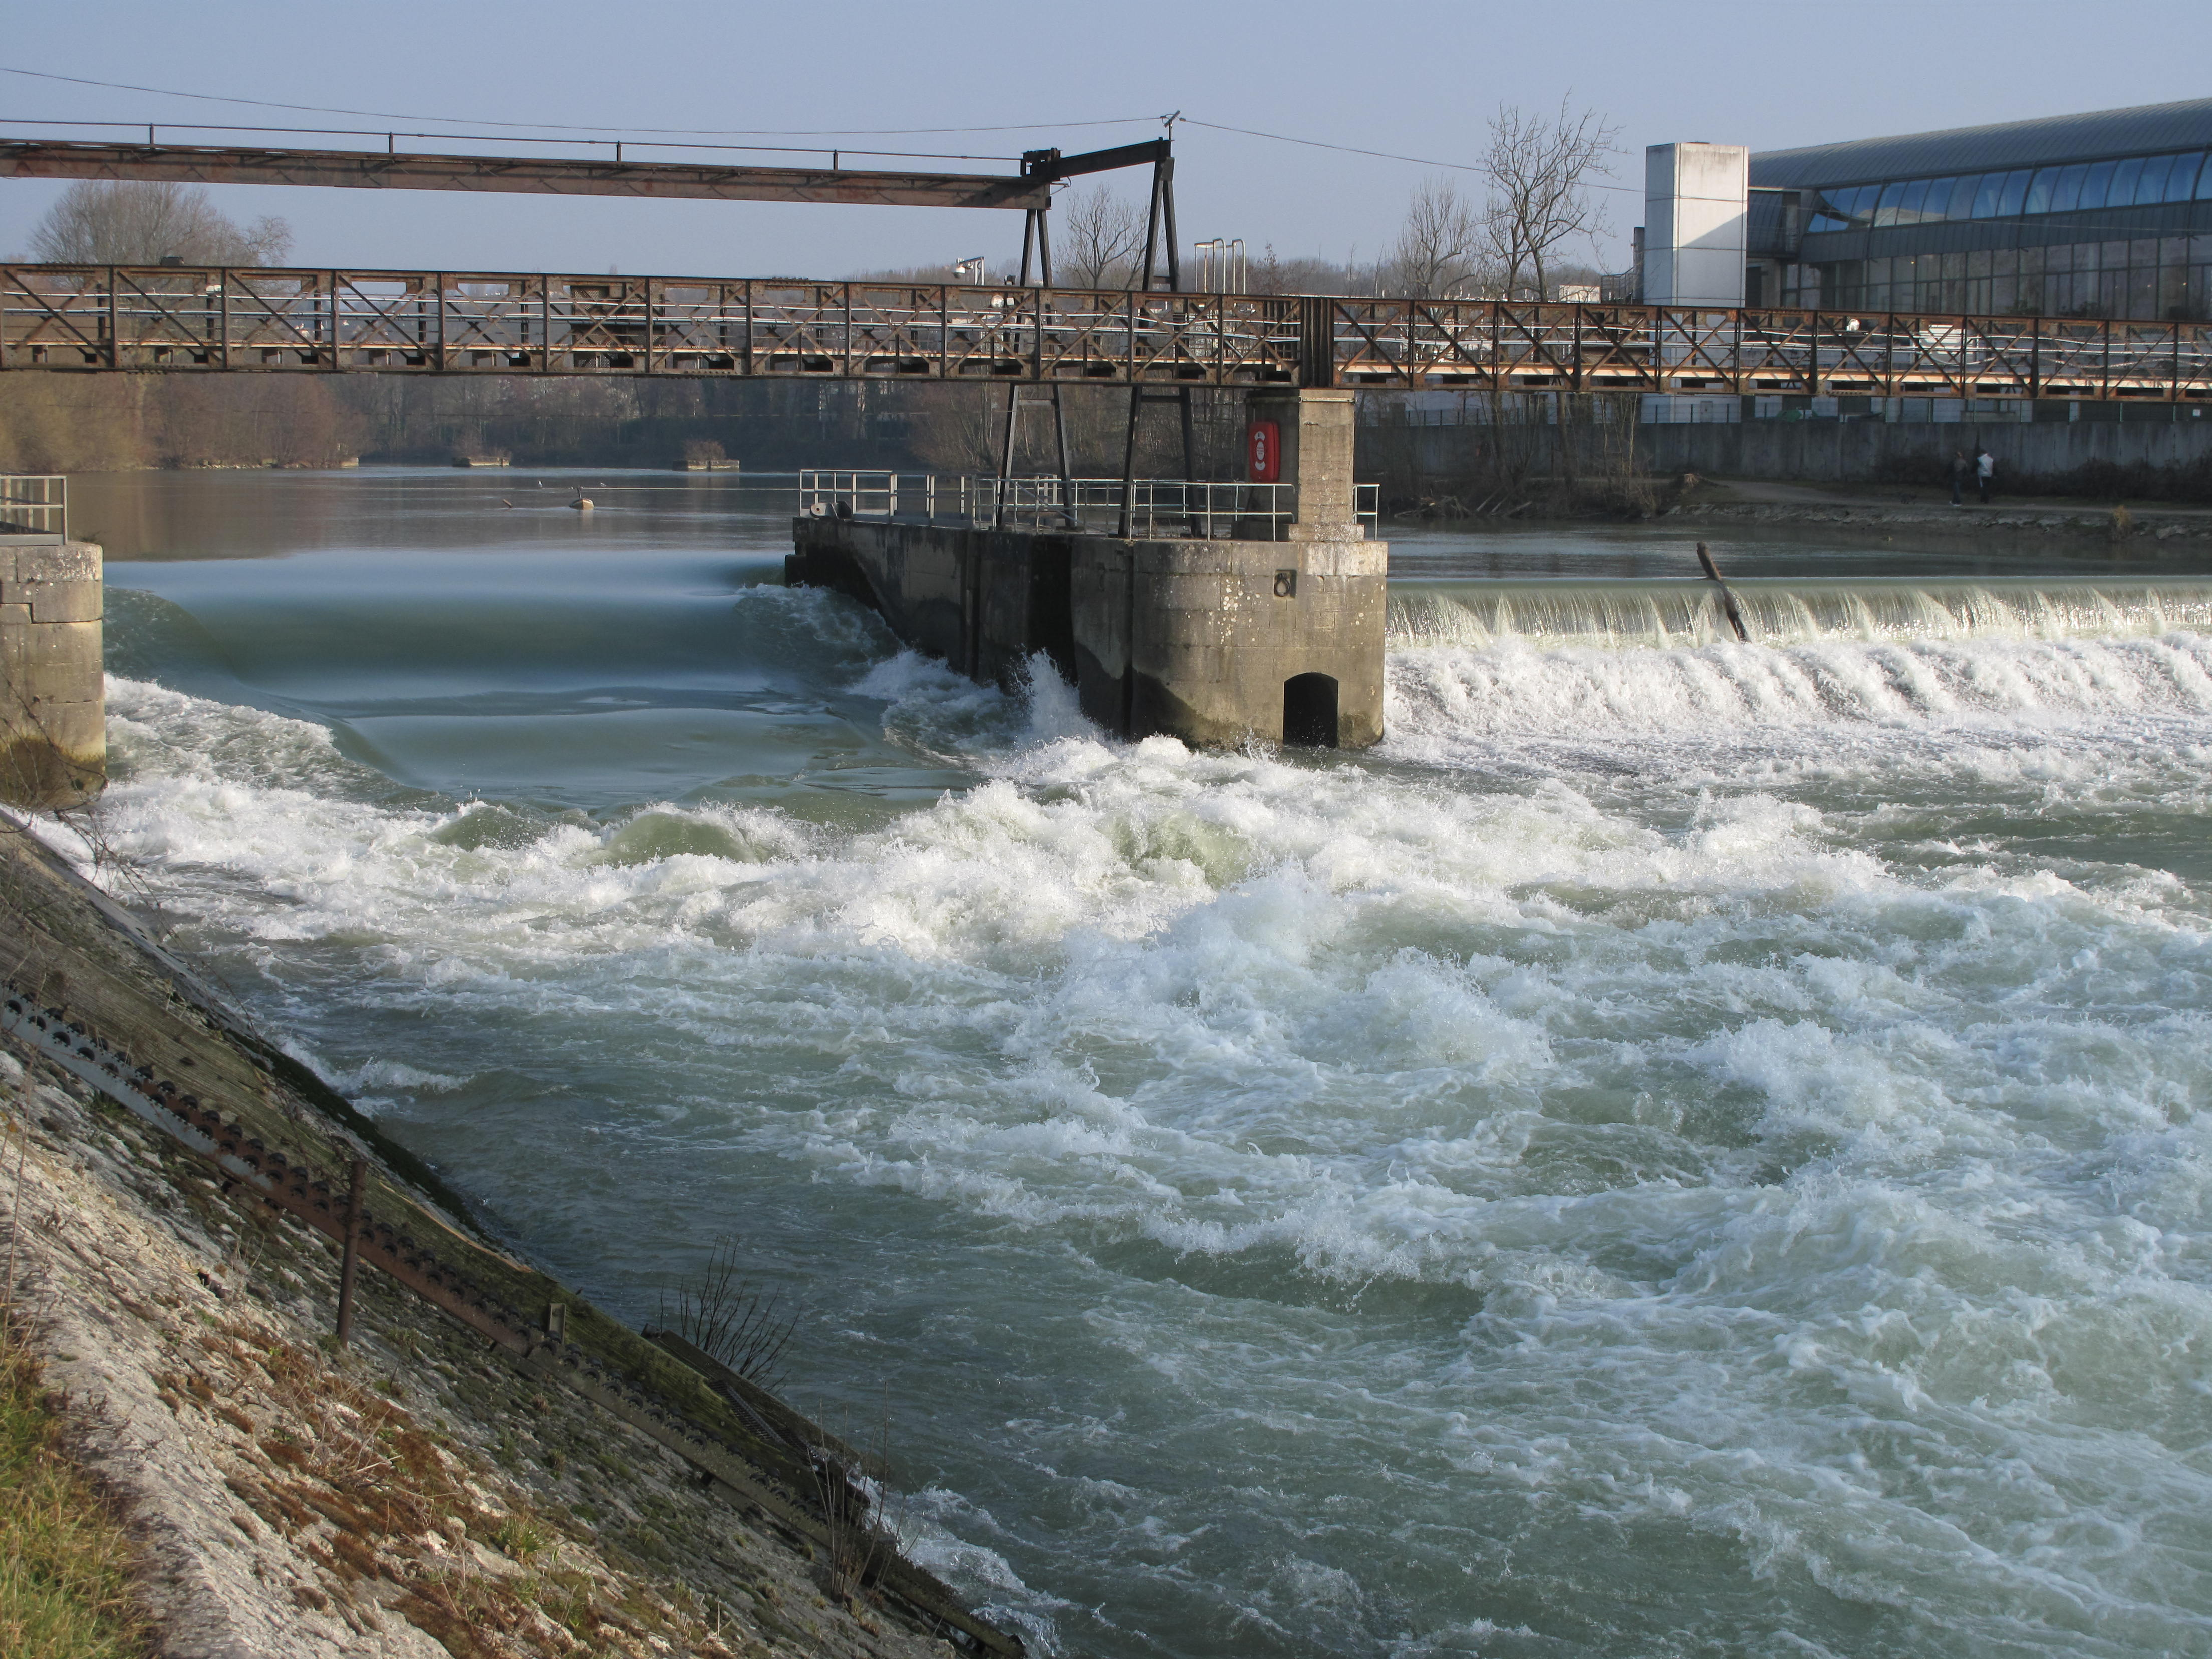
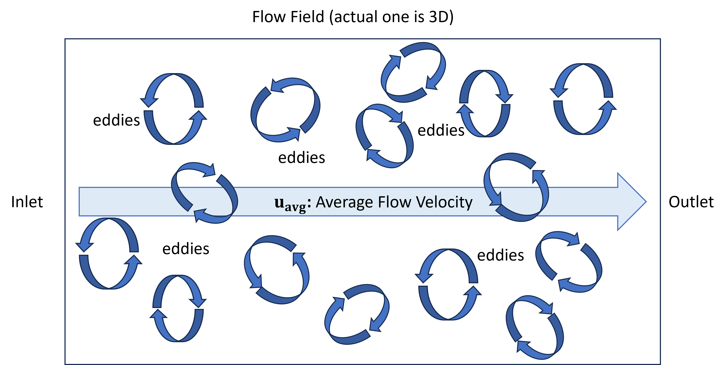
Approximate Turbulent Flow
Credit: https://commons.wikimedia.org/wiki/User:Tangopaso
Phil Du CAS 741

Slide 4
Main Challenge
(Almost) no pseudo-oracle.
Domain expert’s MATLAB code
Likely more useful in proof of concept stage
Only theories on how a correct output should be like.
Phil Du CAS 741

Slide 5
SRS Verification Plan - Functional
Automated Testing:
R1: Verify that the queried point is within the flow field.
R2: Generate a velocity field given any valid eddy profiles input.
R3: (Future) Provide a realistic eddy profile before generation.
R4: Flow field is divergence-free
Manual Testing:
R5: Allow CFD to interface with this software to obtain IC and BC.
Phil Du CAS 741

Slide 6
SRS Verification Plan – Nonfunctional
Manual Testing
NFR1: Accuracy: Suitable as CFD IC/BC
Need to actually run CFD (Suggestions?)
NFR2: Usability: Easy to setup CFD integration
NFR3: Maintainability: Modular and well-documented and modifiable.
NFR4: Portability: Run on any x86-64 based Windows or Linux computer.
Phil Du CAS 741

Slide 7
Test Case: Query Outside Flow Region
Control: Automatic
Initial State: Any
Input: x, y, z that is outside field(Lx, Ly, Lz)
Output: (0, 0, 0), with warning
How to perform: test script
Phil Du CAS 741

Slide 8
Test Case: Eddy – Shape
Control: Automatic
Initial State: Empty Field
Input:
Profile: 1 Eddy with predetermined center location
Query: Opposite points pairs relative to center
Output:
Inside eddy: equal and opposite velocities, magnitude follows shape function
Outside eddy: both (0,0,0)
Phil Du CAS 741

Slide 9
Test Case: Eddy – Velocity std
Control: Automatic
Initial State: Empty Field
Input:
Profile: 1 Eddy with predetermined orientation
Query: Mesh grid of points
Output: Velocities at each point
Should have zero velocity std along the eddy axis
Phil Du CAS 741

Slide 10
Test Case: Field – Zero Sum
Control: Automatic
Initial State: Empty Field
Input:
Profile: Any number of eddies, random orientations
Query: Mesh grid of points, any t
Output: Velocities at each point
Vector sum of all output should be $$u_{avg}$$
Phil Du CAS 741

Slide 11
Test Case: Field – Velocity std vs t
Control: Automatic
Initial State: Empty Field
Input:
Profile: Any number of eddies, random orientations
Query: Mesh grid of points, increasing t
Output: Velocities at each point
Velocity std should stay the same (some tolerance)
Phil Du CAS 741

Slide 12
Test Case: Field – Velocity std vs α
Control: Automatic
Initial State: Empty Field
Input:
Profile: Any number of eddies, random orientations
Query: Mesh grid of points, increasing α: eddy intensity
Output: Velocities at each point
Velocity std should increase with α (trend TBD)
Phil Du CAS 741

Slide 13
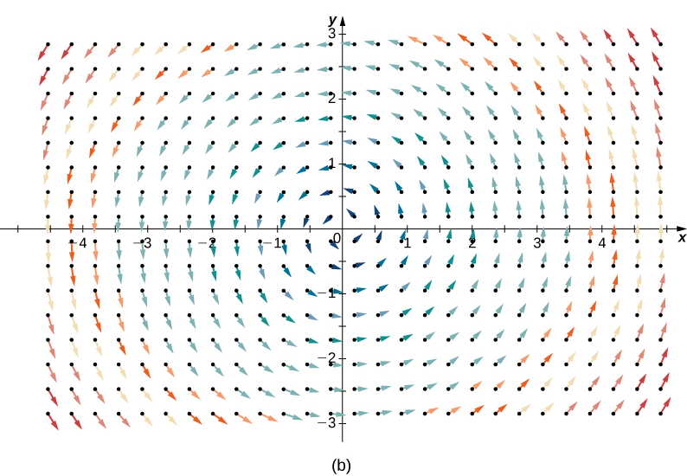
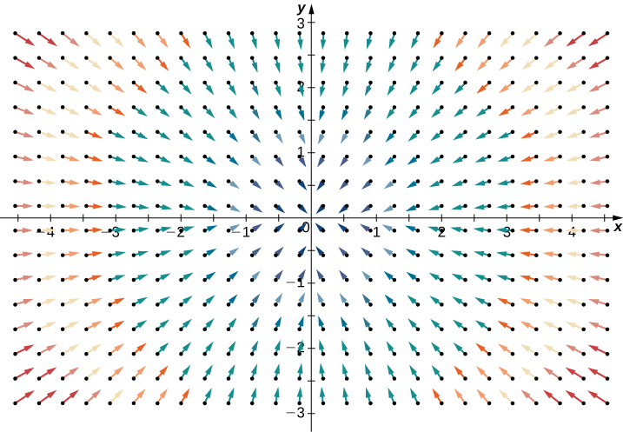
Test Case: Divergence-Free
Control: Automatic
Initial State: Empty Field
Input:
Profile: Any
Query: Mesh grid of points
Output: Velocities at each point
Div(field) < some tolerance
Phil Du CAS 741
Credit: https://openstax.org/books/calculus-volume-3/pages/6-5-divergence-and-curl

Slide 14
Test Case: NFR – Maintainability
Type: Static + Dynamic
How test will be performed:
Provide an alternative shape function (mathematical)
Ask the reviewer to modify the code to implement it
With no help other than documentation that comes with the software
Survey how easy it is
Check if the code still passes all the automatic tests.
Phil Du CAS 741
Credit: https://openstax.org/books/calculus-volume-3/pages/6-5-divergence-and-curl

Slide 15
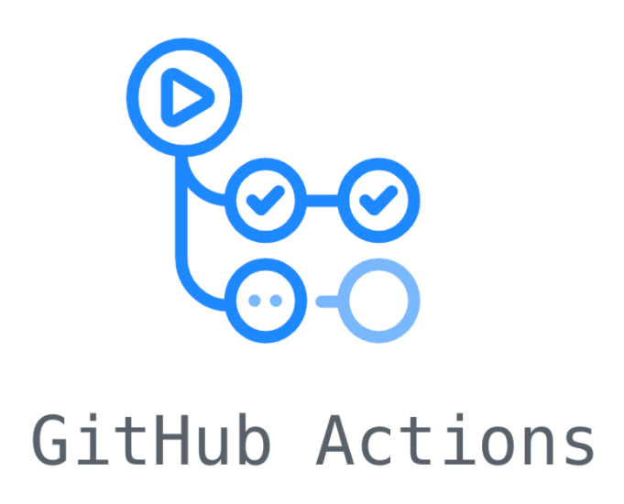
Automated Tools
Profiling Tool: likely no need
Continuous Integration
Test scripts
GitHub Actions
Linter: VS Code Extension
Code Coverage: Coverage.py
Phil Du CAS 741

Slide 16
Really, I’m here for suggestions...
Anything goes, thanks!
Phil Du CAS 741

